Slide 1
Tutorial 07
Designing a Web Form

Slide 2
Objectives
Explore web forms
Work with form servers
Create forms and field sets
Create labels and input boxes
Explore form layout
Work with date and time fields
Create a selection list

Slide 3
Objectives (continued)
Create option buttons
Create check boxes and text area boxes
Create spinners and range sliders
Use data lists
Create form buttons
Validate a form
Apply validation styles

Slide 4
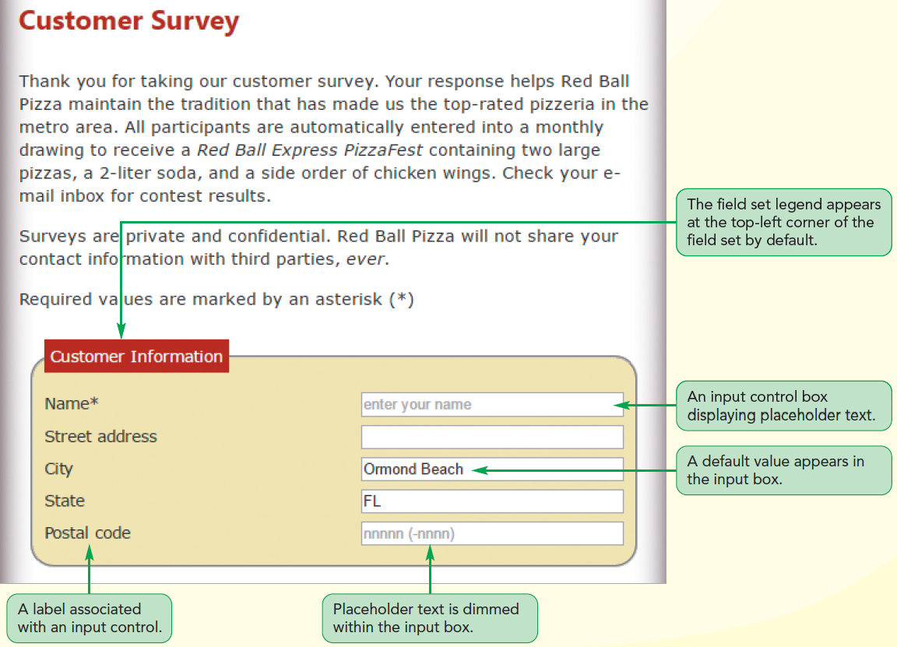
Structure of a Web Form

Slide 5
Introducing Web Forms
Web form
  Allows users to enter data that can be saved and processed
  Common way to accept user input
  Allows the creation of interactive websites for user feedback

Slide 6
Parts of a Web Form
Controls, also known as widgets, are the objects that allow a user to interact with a form
Each data entry control is associated with a data field
Data field: Stores the data values supplied by a user

Slide 7
Parts of a Web Form (continued 1)
Types of controls
  Input boxes to insert text and numeric values
  Option/radio buttons to select data values from a predefined set of options
  Selection lists to select data values from an extensive list of options
  Check boxes to select data values limited to two possibilities, such as “yes” or “no”
  Text area boxes to enter text strings that may include several lines of content

Slide 8
Parts of a Web Form (continued 2)
Types of widgets
  Spin boxes to enter integer values confined to a specified range
  Slider controls to enter numeric values confined to a specified range
  Calendar controls to select date and time values
  Color pickers to choose color values

Slide 9
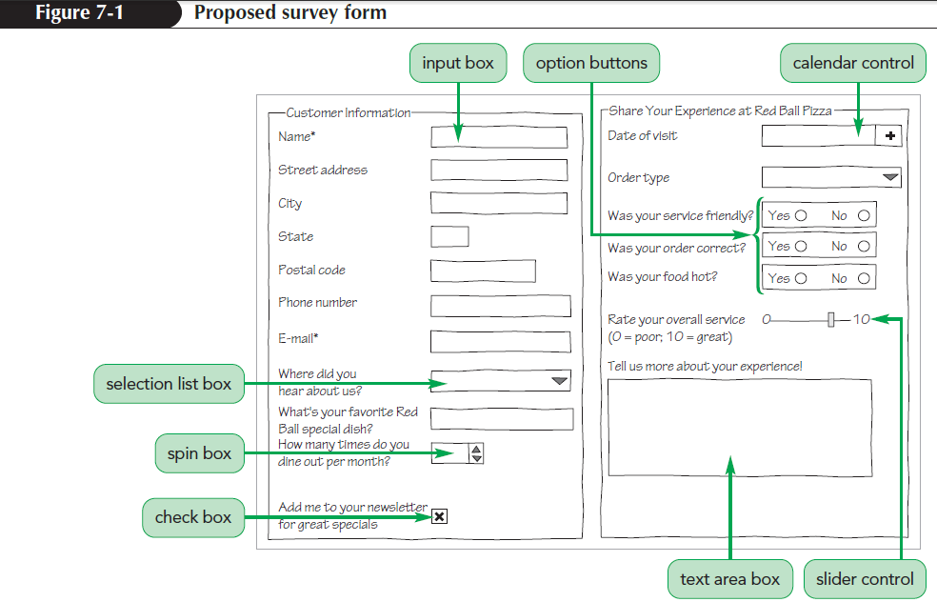
Parts of a Web Form (continued 3)

Slide 10
Forms and Server-Based Programs
Field values entered by a user are processed by a program running on the user’s computer or on a web server in a secure location
Example: A web form is used to collect data from a customer for an order and the server program processes the data and handles the billing and delivery

Slide 11
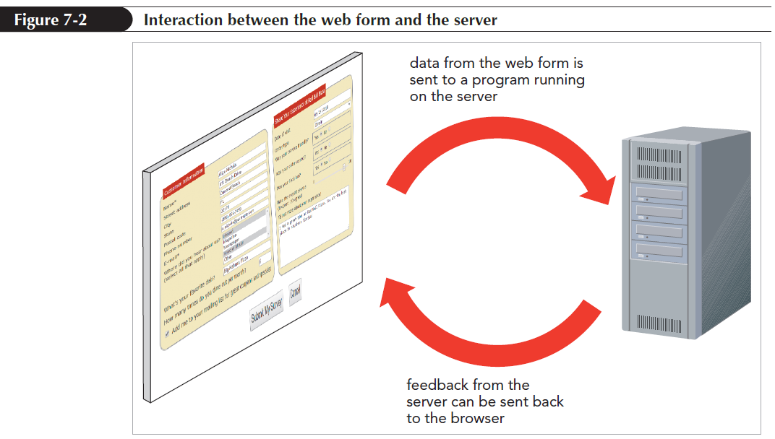
Forms and Server-Based Programs
(continued)

Slide 12
Starting a Web Form
Web forms are marked using the form element
<form id=“text” attributes>
content
</form>
where id identifies the form, attributes specify how the form should be processed by the browser and content is the form’s content

Slide 13
Starting a Web Form (continued 1)
A form element can be placed anywhere within the body of a page
Forms can contain page elements such as tables, paragraphs, inline images, and headings

Slide 14
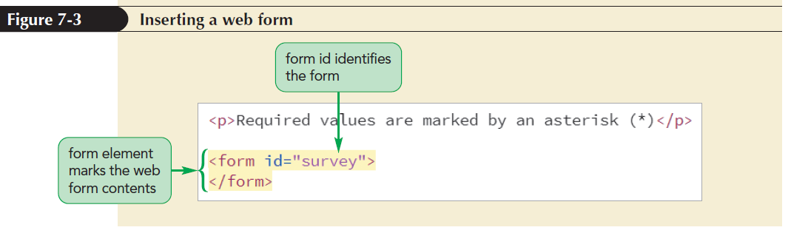
Starting a Web Form (continued 2)

Slide 15
Interacting with the Web Server
The action, method, and enctype attributes have to be included in a form to specify where and how to send the form data
<form action=“url” method=“type” enctype=“type”>
content
</form>

Slide 16
Interacting with the Web Server (continued 1)
  Where:
  the action attribute provides the location of the web server program that processes the form
  the method attribute specifies how the browser should send form data to the server
  the enctype attribute specifies how the form data should be encoded as it is sent to the server

Slide 17
Interacting with the Web Server (continued 2)
Two possible values for method attribute
  get method: Tells the browser to append the form data to the end of the URL specified in the action attribute
  The get method is the default method
  post method: Sends the form data in its own separate data stream
  The post method is considered to be a more secure form of data transfer
The enctype attribute has three possible values

Slide 18
Interacting with the Web Server (continued 3)
Value | Description
application/x-www-form-urlencoded | The default format in which the data is encoded as a long text string with spaces replaced by the + character and special characters (including tabs and line breaks) replaced with their hexadecimal code values
multipart/form-data | The format used when uploading files in which no encoding of the data values occurs
text/plain | The format in which data is transferred as plain text with spaces replaced with the + character but no other encoding of the data values occurs

Slide 19
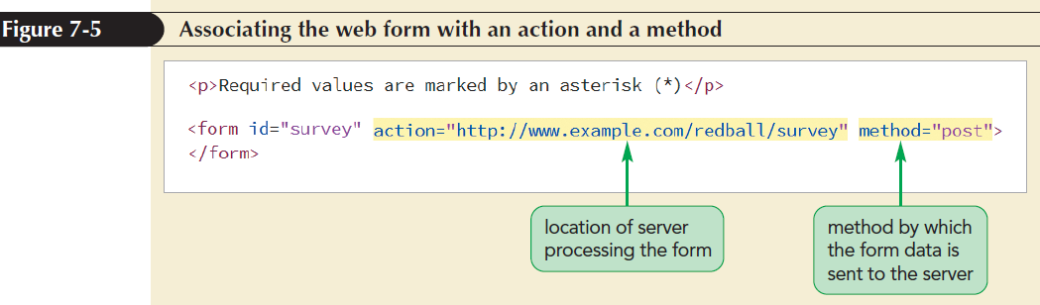
Interacting with the Web Server (continued 4)

Slide 20
Interacting with the Web Server (continued 5)
A script element is an HTML element used to access and run JavaScript programs that will run within the user’s browser
<script src="rb_formsubmit.js"></script>

Slide 21
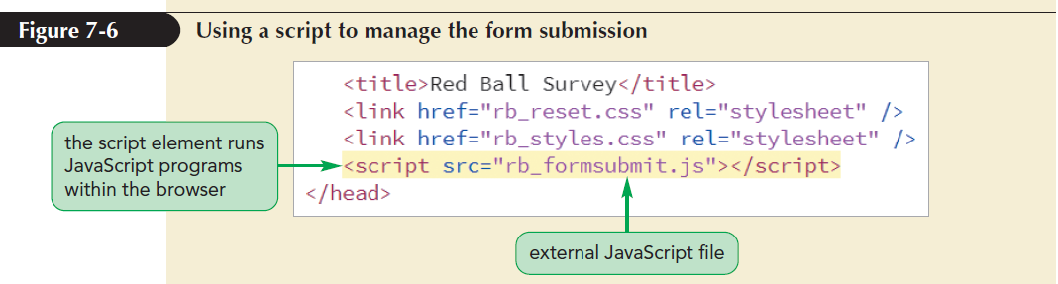
Interacting with the Web Server (continued 6)

Slide 22
Creating a Field Set
Field set: Groups fields that share a common purpose
Field sets are created using the fieldset element
<fieldset id=“id”>
content
</fieldset>
where id identifies the field set and content is the form content within the field set

Slide 23
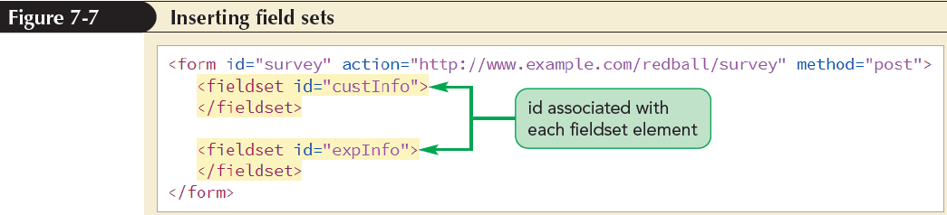
Marking a Field Set

Slide 24
Adding a Field Set Legend
A legend describes the content of a field set using the legend element
  <legend>text</legend>
  where text is the text of the legend
The legend element contains only text and no nested elements
By default, legends are placed in the top-left corner of the field set box and can be moved to a different location using the CSS positioning styles

Slide 25
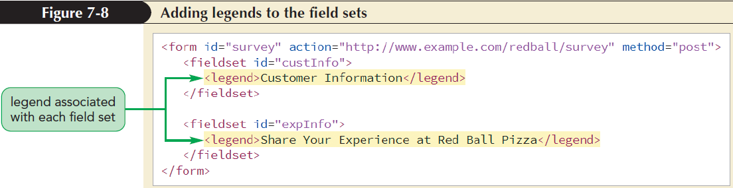
Adding a Field Set Legend (continued)

Slide 26
Creating Input Boxes
Syntax for the input element
  <input name=“name” id=“id” type=“type” />
  The name attribute provides the name of the data field associated with the control
  The id attribute identifies the control in which the user enters the field value
  The type attribute indicates the data type of the field

Slide 27
Creating Input Boxes (continued 1)
Type Value | Control Displayed by the Browser
button | A button that can be clicked to perform an action
checkbox | A check box for yes/no or true/false responses
color | A widget from which users can select a color
date | A widget from which users can select a calendar date
datetime-local | A widget from which users can select a calendar date and time
email | An input box used for email addresses
file | A widget from which users can select a local file
Hidden | A control that is hidden from the user
image | An image that can be clicked to perform an action
month | A widget from which users can select a calendar month and year
number | A spin box from which users can select a numeric value

Slide 28
Creating Input Boxes (continued 2)
Type Value | Control Displayed by the Browser
password | An input box in which the entry value is hidden by * symbols
radio | A radio or option button that can be clicked by the user
range | A slider from which users can select a numeric value within a defined range
reset | A button that can be clicked to reset the web form
search | A widget that can be used to search for a defined term
submit | A button that can be clicked to submit the form for processing
tel | An input box used for telephone numbers
text | An input box used for text entries (the default)
time | A widget from which users can select a time value
url | An input box used for entering URLs
week | A widget from which users can select a week value

Slide 29
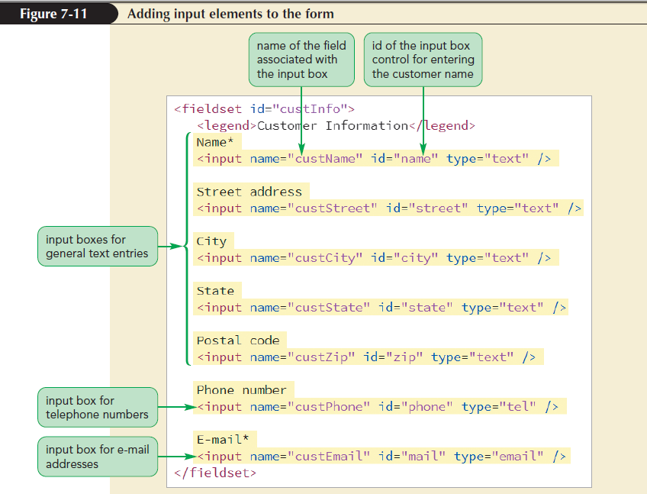
Creating Input Boxes (continued 3)

Slide 30
Input Types and Virtual Keyboards
Virtual keyboards are software representations of a physical device
Web forms can be made responsive by displaying different virtual keyboards for each input type
Example: An input box for telephone number is more convenient to read with digits displayed prominently on the keyboard

Slide 31
Adding Field Labels
To associate a text string with a control, the text string must be enclosed within the label element:
  <label for=“id”>label text</label>
  where id is the id of the control that is associated with the label and label text is the text of the label

Slide 32
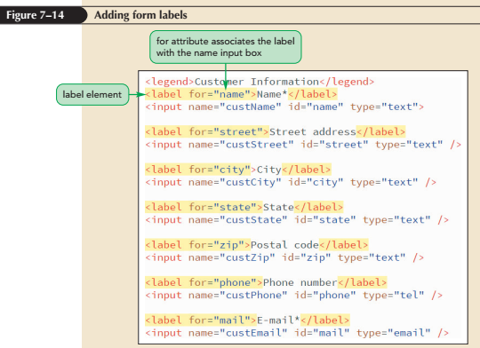
Adding Field Labels (continued)

Slide 33
Designing a Form Layout
There are two general layouts
  Labels are placed directly above the input controls
  Labels and controls are placed side-by-side

Slide 34
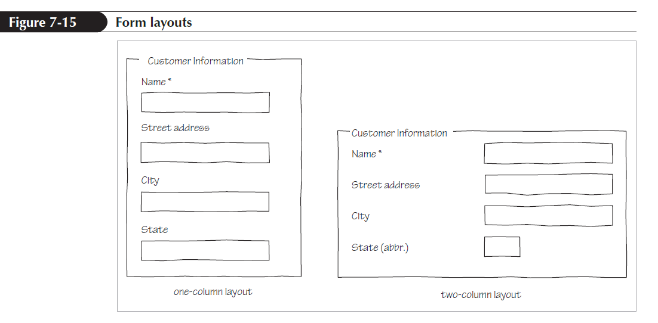
Designing a Form Layout (continued)

Slide 35
Defining Default Values and Placeholders
The value attribute is used to specify a default field value
Placeholders: Text strings that appear within a form control, providing a hint about the kind of data that should be entered into a field
They are defined using the placeholder attribute
  placeholder=“text”
where text is the text of the placeholder

Slide 36
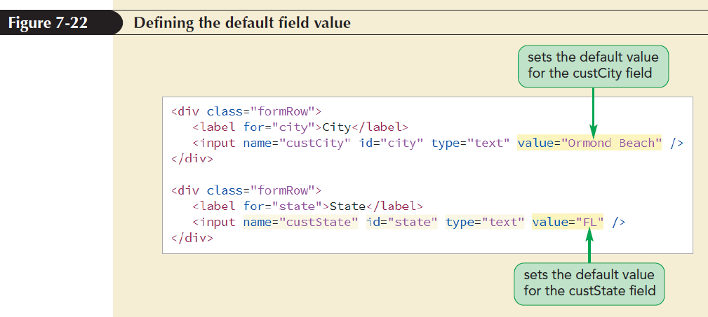
Defining Default Values and Placeholders (continued 1)

Slide 37
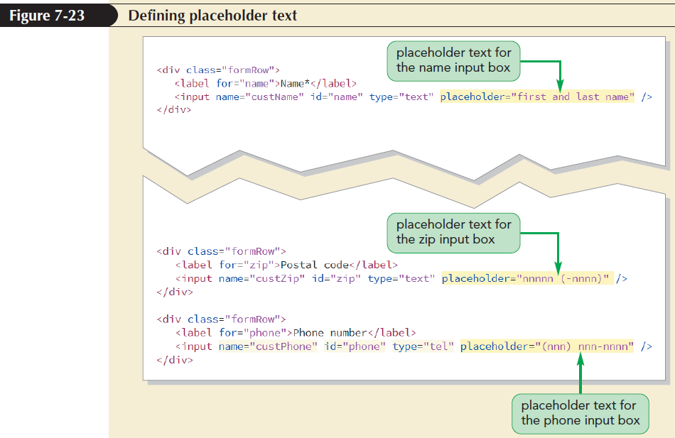
Defining Default Values and Placeholders (continued 2)

Slide 38
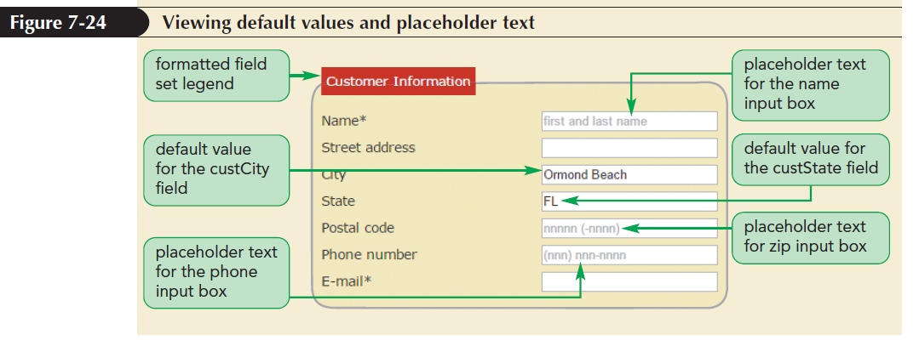
Defining Default Values and Placeholders (continued 3)

Slide 39
Entering Date and Time Values
Date and time fields ensure that users enter data in the correct format
Indicated using type attributes:
  date
  time
  datetime-local
  month
  week

Slide 40
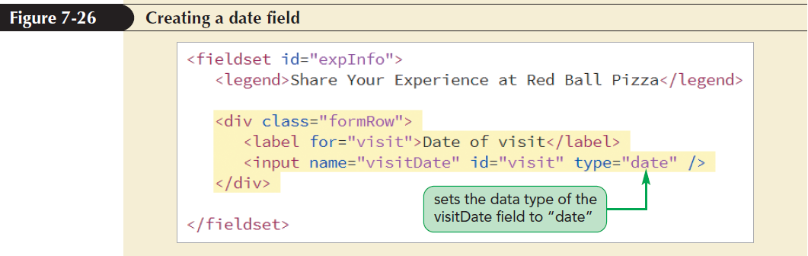
Entering Date and Time Values (continued)

Slide 41
Creating a Selection List
A selection list is a list box that presents users with a group of possible values for the data field
The list is created using the select and option elements
  <select name=”name”>
  <option value=”value1”>text1</option>
  <option value=”value2”>text2</option>
  ...
  </select>

Slide 42
Creating a Selection List (continued 1)
  Where
    name is the name of the data field
    value1, value2,… are the possible field values
    text1, text2,… are the text of the entries in the selection list that users see on the web form

Slide 43
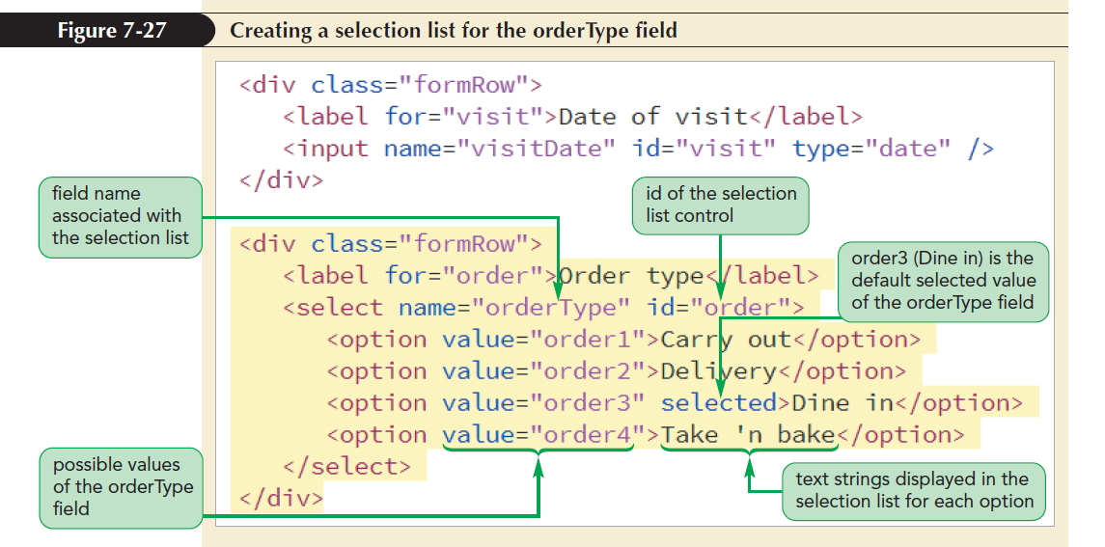
Creating a Selection List (continued 2)

Slide 44
Working with select Attributes
By default, a selection list appears as a drop-down list box
To display a selection list as a scroll box, use the size attribute to the select element:
<select size=“value”> ... </select>
where value is the number of options that the selection list displays at one time

Slide 45
Working with select Attributes
(continued 1)
By default, selection lists allow only one selection from the list of options
To allow more than one item to be selected, add the multiple attribute
  <select multiple> ... </select>

Slide 46
Working with select Attributes
(continued 2)
Two ways for users to select multiple items from a selection list
  For non-contiguous selection, press and hold the Ctrl key while making the selections
  For contiguous selection, select the first item, press and hold the Shift key, and then select the last item in the range

Slide 47
Grouping Selection Options
Organize selection list options by placing them in option groups using the optgroup element
  <select>
  <optgroup label=”label1”>
  <option>text1</option>
  <option>text2</option>
  </optgroup>
  </select>
where label1 is the label for the different groups of options

Slide 48
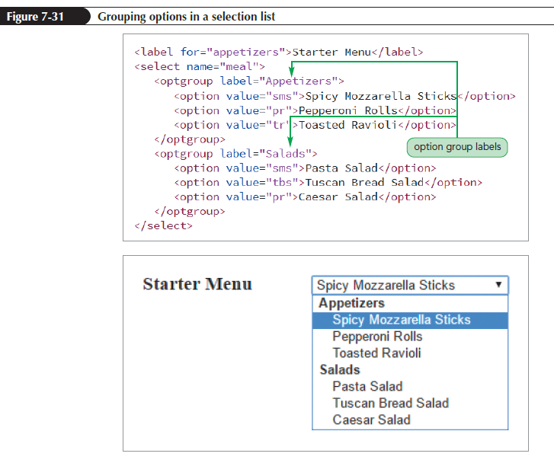
Grouping Selection Options (continued)

Slide 49
Creating Option Buttons
Option buttons are also called radio buttons
Unlike selection lists, the options appear as separate controls in the web form
They are created with a group of input elements with a type attribute value of “radio”
  <input name=“name” value=“value1” type=“radio” />

Slide 50
Creating Option Buttons (continued 1)
  <input name=“name” value=“value2” type=“radio” />
  …
where name is the name of the data field and value1, value2, … are the field values associated with each option
Set an option button to be selected as the default by adding the checked attribute to the input element
<input name=”name” type=”radio” checked />

Slide 51
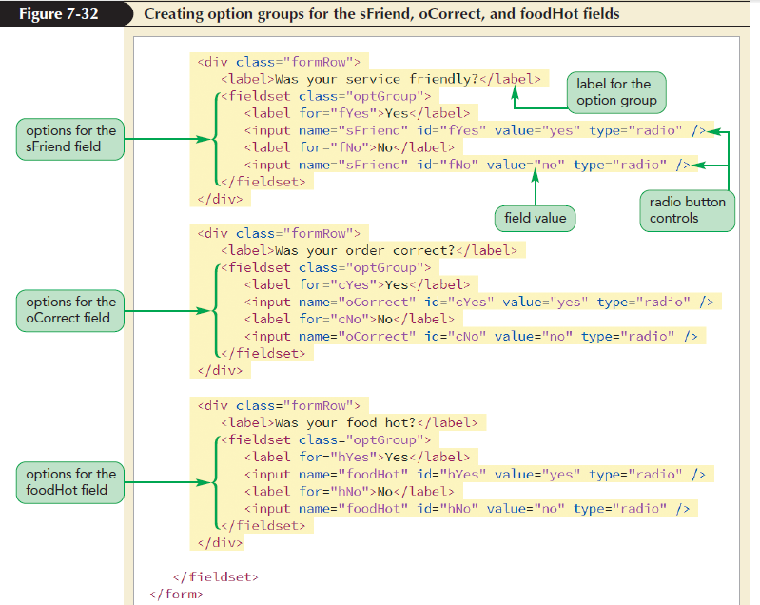
Creating Option Buttons (continued 2)

Slide 52
Creating Check Boxes
Check boxes are designed for fields that record the presence or absence of an object or event
They are created using the input element with the type attribute set to “checkbox”
<input name=“name” value=“value” type=“checkbox” />
  where value attribute contains the value of the field when the check box is checked and type attribute indicates that the input box is a check box

Slide 53
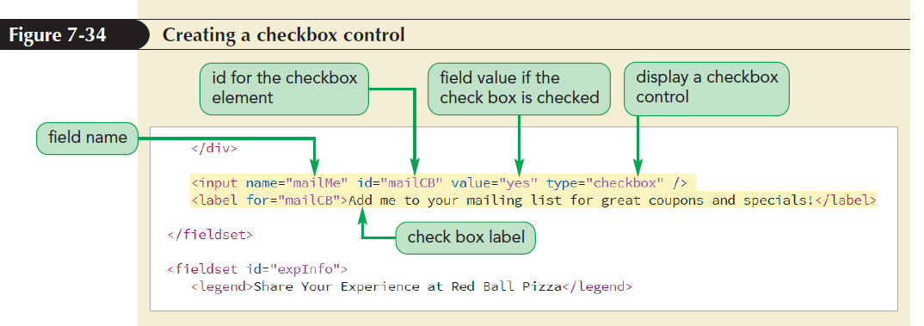
Creating Check Boxes (continued)

Slide 54
Creating a Text Area Box
Text area is created using the textarea element
  <textarea name=“name”>
  text
  </textarea>
  where text is the default value of the data field

Slide 55
Creating a Text Area Box
(continued 1)
  HTML supports the rows and cols attributes to set the text area size
    <textarea rows=”value” cols=”value”>
    ...
    </textarea>
    Where the rows attribute specifies the number of lines in the text area box and the cols attribute specifies the number of characters per line

Slide 56
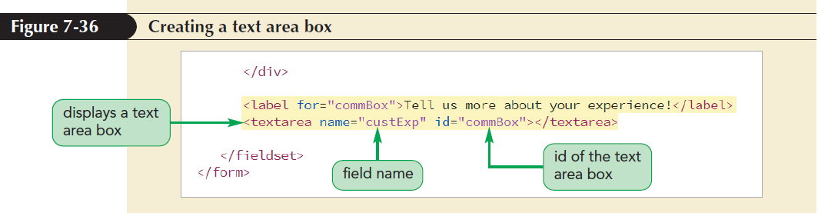
Creating a Text Area Box
(continued 2)

Slide 57
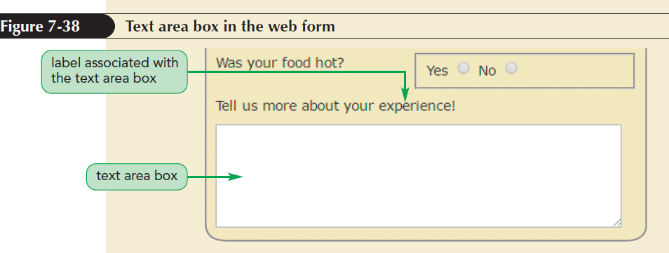
Creating a Text Area Box
(continued 3)

Slide 58
Entering Numeric Data
Creating a Spinner Control
  Spinner control: Displays an up or down arrow to increase or decrease the field value by a set amount
  To create a spinner control, apply the input element using the number data type

Slide 59
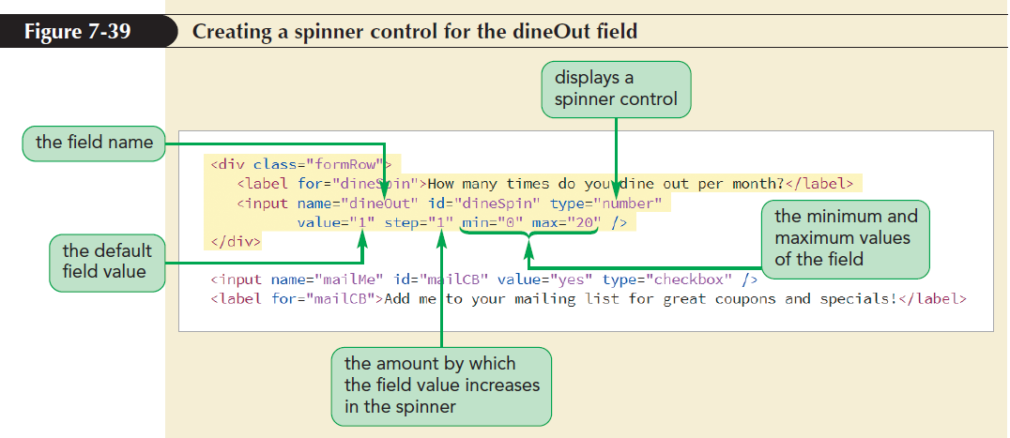
Entering Numeric Data (continued 1)

Slide 60
Entering Numeric Data (continued 2)
Creating a Range Slider
  Slider control: Limits a numeric field to a range of possible values
  To create a slider control, apply the range data type in the input element

Slide 61
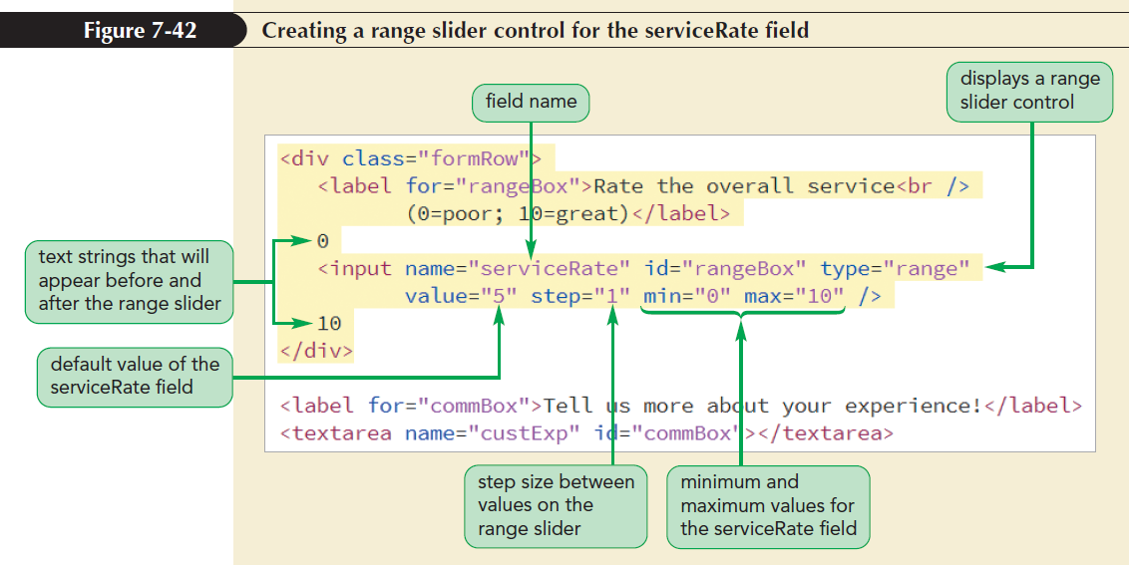
Entering Numeric Data (continued 3)

Slide 62
Suggesting Options with Data Lists
Data list: A list of possible data values that a form field can have
Data lists are defined using the datalist element
  <datalist id=”id”>
<option value=”value” />
<option value=”value” />
…
</datalist>

Slide 63
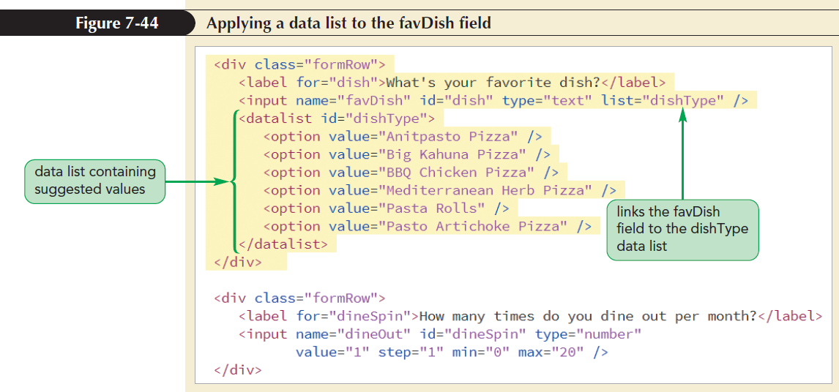
Suggesting Options with Data Lists (continued)

Slide 64
Working with Form Buttons
Form buttons: A type of form control that performs an action
Actions performed
  Run a command from a program linked to the web form
  Submit the form to a program running on the web server
  Reset the form fields to their default values

Slide 65
Creating a Command Button
Command button: Runs a program that affects the content of a page or the actions of a browser
Created using the input element with the type attribute set to button
  <input value=“text” onclick=“script” type=“button” />
where text is the text that appears on the button and script is the name of the program code that is run when the button is clicked by the user

Slide 66
Creating Submit and Reset Buttons
Submit button: Submits a form to the server for processing when clicked
Submit button is created using input elements with the type attribute set to “submit” and “reset” respectively
  <input value=“text” type=“submit” />
where text is the text string that appears on the button

Slide 67
Creating Submit and Reset Buttons (continued 1)
Reset button: Resets a form, changing all fields to their default values and deleting any field values that a user has entered
Reset button is created using input elements with the type attribute set to “reset”
  <input value=“text” type=“reset” />
where text is the text string that appears on the button

Slide 68
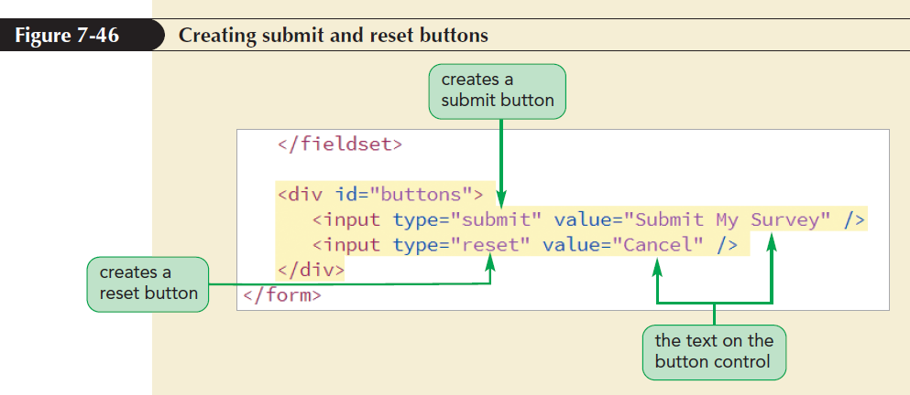
Creating Submit and Reset Buttons (continued 2)

Slide 69
Designing a Custom Button
The appearance of a command, submit, and reset button is determined by the browser
For more control over a button’s appearance use the button element
<button type=“text”>
content
</button>
Where the type attribute specifies the button type and content are HTML elements placed within the button

Slide 70
Validating a Web Form
Validation: Process of ensuring that a user has supplied valid data
Types of validation
  Server-side validation – validation occurs on the web server
  Client-side validation – validation occurs in the user’s browser

Slide 71
Identifying Required Values
The first validation test is to verify if data is supplied for all the required data fields
Add the required attribute to the control to identify the required data fields
If a required field is left blank, the browser will not submit the form returning an error message to indicate the unavailability of data

Slide 72
Validating Based on Data Type
A form fails the validation test if the data values entered into a field do not match the field type
Example:
  A data field with the number type will be rejected if nonnumeric data is entered
  Fields with email and url types will be rejected if a user provides an invalid e-mail address or text that does not match the format of a URL

Slide 73
Testing for a Valid Pattern
To test whether a field value follows a valid pattern of characters, test the character string against a regular expression
Regular expression or regex is a concise description of a character pattern
To validate a text value against a regular expression, add the pattern attribute to the input element

Slide 74
Testing for a Valid Pattern (continued)
Example: The value of the custZip field against the regular expression pattern ^\d{5}$
  <input name=“custZip” pattern=“^\d{5}$” />
  where regular expression ^\d{5}$ represents any string of five numeric characters

Slide 75
Defining the Length of the Field Value
The syntax to define the maxlength attribute is <input maxlength=“value” />
where value is the maximum number of characters in the field value
Example:
  <input name=”custZip” maxlength=“5” />
  The maxlength attribute does not distinguish between characters and digits

Slide 76
Applying Inline Validation
Inline validation: The technique of immediate data validation and reporting of errors
The focus pseudo-class is used to change the display style of fields that currently contain invalid data
Focus: The state in which an element has been clicked by the user, making it the active control on the form

Slide 77
Applying Inline Validation
(continued 1)
Pseudo-Class | Matches
checked | A check box or option button that is selected or checked
default | A default control, such as the default option in a selection list
disabled | A control that is disabled
enabled | A control that is enabled
focus | A control that has the focus (is actively selected) in the form
indeterminate | A check box or option button whose toggle states (checked or unchecked) cannot be determined

Slide 78
Applying Inline Validation
(continued 2)
Pseudo-Class | Matches
in-range | A field whose value lies within the allowed range (between the min and max attribute values)
invalid | A field whose value fails the validation test
optional | A field that is optional (not required) in the form
out-of-range | A field whose value lies outside the allowed range (outside the min and max attribute values)
required | A field that is required in the form
valid | A field whose value passes the validation test

Slide 79
Applying Inline Validation
(continued 3)
Example: To create styles for all of the checked option buttons in the form, apply the checked pseudo-class
input[type=”radio”]:checked {
styles
}
where styles are the CSS styles applied to checked option buttons

Slide 80
Pseudo-Classes for Valid and Invalid Data
The valid and invalid pseudo-classes are used to format controls based on whether their field values pass/fail a validation test
Example: To display input elements containing valid data with a light green background, use the following style rule:
  input:valid {
  background-color: rgb(220, 255, 220);
  }

Slide 81
Pseudo-Classes for Valid and Invalid Data (continued 1)
Example: To display input elements containing invalid data with a light red background with focus, use the following style rule:
  input:focus:invalid {
  background-color: rgb(255, 232, 233);
  }

Slide 82
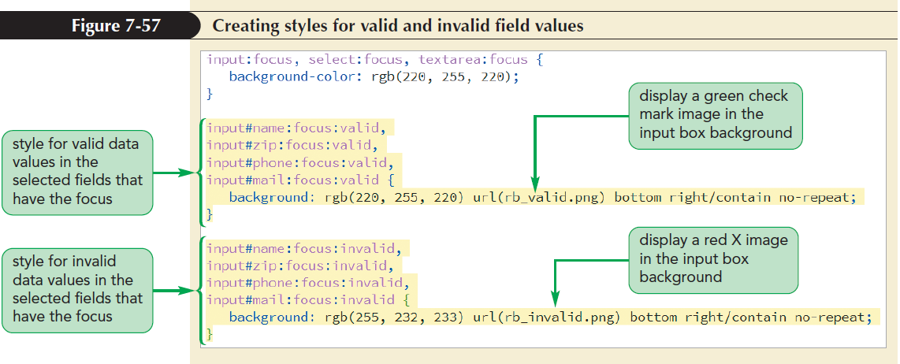
Pseudo-Classes for Valid and Invalid Data (continued 2)

